Slide 1
Introduction Slides
14/08/23

Slide 2
This weeks content is divided into three parts
Design and Implementation of a DSP Based Digital Controller for a DC-DC Converter
TMS320F28335 DSP Programming using MATLAB Simulink Embedded Coder.
Closed loop current mode DC\DC Boost Converter

Slide 3
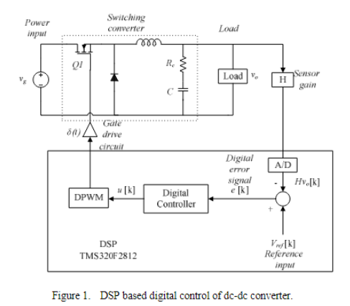
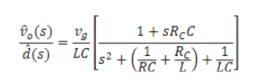

Typical structure of a TMS320F2812
Transfer function of a well known small signal model for the converter

Slide 4
Design and Implementation of a DSP Based Digital Controller for a DC-DC Converter

Slide 5
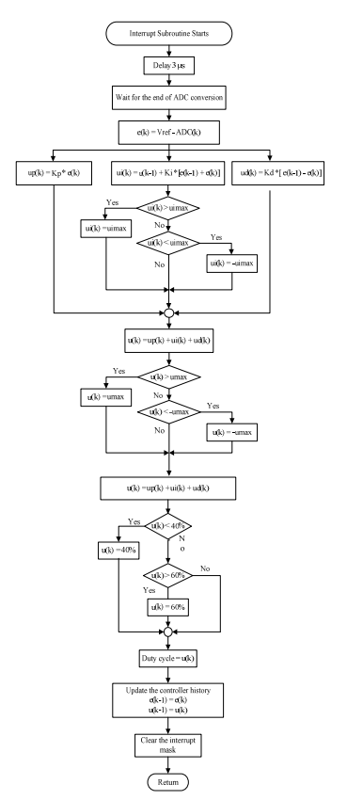
Design sampling loop implementation
1. Sampling Scheme and ADC Triggering:
- The sampling scheme impacts digital controller design and requires careful consideration.
- TMS320F2812 ADC can be triggered by EVA/B, external pins, or software.
- Prototype uses T2CMPR (GP Timer 2 compare) of EVA to trigger ADC for flexible trigger points within PWM period.
2. ADC Conversion Process:
- SOC (start of conversion) initiated by T2CMPR, EOC (end of conversion) triggers an interrupt.
- ADC interrupt routine executed after conversion completion.
- ISR reads converted value, applies designed controller (Equation 4), updates PWM duty ratio.

Slide 6
3. PWM Frequency Setup:
- PWM output frequency set using on-chip timers.
- GP Timer 1 (T1) establishes PWM switching frequency (20 kHz).
- Timer compare registers used to input calculated duty ratio values.
4. Generating PWM Output:
- Compare values are compared with timer counter for PWM output generation.
- PWM control registers configured to update PWM duty ratio at the start of the subsequent T1 timer period.
5. Flowchart of ISR:
- Flowchart illustrates the interrupt service routine (ISR) using a TMS320F2812 DSP evaluation module.
- ISR involves reading ADC result, applying control algorithm, updating PWM, and recalculating PWM modulated value.

Slide 7
Paper 2: TMS320F28335 DSP Programming using MATLAB
Simulink Embedded Coder: Techniques and
Advancements

Slide 8
CCSV6 TARGET CONFIGURATION
The first step is to make sure that Code Composer Studio (CCS) version 6 or 5 is installed.
Even though matlab 2015a was suggested for the code generation, we couldn’t figure out a way to set it up properly. Everything was done in 2023a.
Overall, It provides the necessary information and steps to configure the DSP target for programming using MATLAB Simulink Embedded Coder and CCS V6.

Slide 9
FLASH memory Programming (stand-alone mode)
FLASH memory Programming (stand-alone mode)" refers to a method of programming the TMS320F28335 DSP where the program is saved in the flash memory of the DSP. This means that the program will not be erased when the DSP control card is unplugged from the computer.
Debug Configurations and Code Running: Debug Configurations and Code Running refer to the process of generating and deploying the code to the TMS320F28335 DSP. To generate the code, the user can click the "Deploy to Hardware" (build model) icon in Simulink. This will build a .out file, which is a downloadable program file in Code Composer Studio (CCS) V6.

Slide 10
PWM, ADC, GPIO AND PI BLOCKS
PWM, ADC, GPIO, and PI blocks are specific blocks that can be used in Simulink to program the TMS320F28335 DSP.
Pulse width modulation : The TMS320F28335DSP has up to 18 PWM outputs which can be controlled using the ePWM blocks
Analog to digital converter : The ADC block can be used to perform analog-to-digital conversion of signals connected to the selected ADC input pins.
General-purpose input/output : The GPIO blocks can be used to control the general-purpose input/output pins of the DSP.
Proportional-integral Block : The PI block can be used to implement a proportional-integral controller in the Simulink model.

Slide 11
CONCLUSION
Implementation of signals via CCS is often difficult, this process can be vastly simplified by using MATLAB. Matlab has simulink coder and embedded coder which can efficiently convert simulink files to be readily deployable to hardware. This ensures that the end user does not have to manually code everything up. This paper covers the implementation of TI Delfino 2833x microcontroller chipsets and implementation in MATLAB and gives a brief overview of implementation of the solution stated above.

Slide 12
Paper 3: Closed Loop Current Mode DC/DC Boost Converter

Slide 13
Introduction
The file is about Closed Loop Current Mode DC/DC Boost Converter and how it can be used to efficiently convert unregulated DC voltage to regulated DC voltage.
The introduction highlight the working of a basic boost converter.

Slide 14
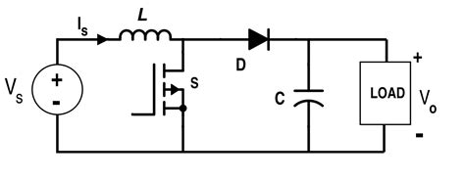
Basic description of DC/DC boost converter
The boost converter is a type of DC/DC converter that is commonly used in non-isolated circuits. It consists of a DC input voltage source (Vs), an inductor, a filter capacitor, a controllable switch (Q), a diode (D), and a load resistance (R).
The boost converter is designed to increase the output voltage to a level that is higher than the input DC voltage
The boost converter operates by storing energy in the inductor during the on-time of the switch and releasing it to the output during the off-time of the switch.

Slide 15
Continuous Current Mode: The portion of the switching period over which the inductor current of the converter is never zero is called continuous current mode (CCM)
Discontinous Current Mode: When the inductor current is zero during switching period the converter is said to be operating in discontinuous current mode (DCM)
The voltage gain of the converter is given by the equation Vo = D * Vs / (1 - D), where Vo is the output voltage, Vs is the input voltage, and D is the duty cycle of the PWM signal.

Slide 16
Selection of components of boost converter
The following parameters need to be considered:
Input Voltage
Output Voltage
Switching Frequency
Inductor and Capacitor value
Switching device (MOSFET)
Efficiency and thermal considerations

Slide 17
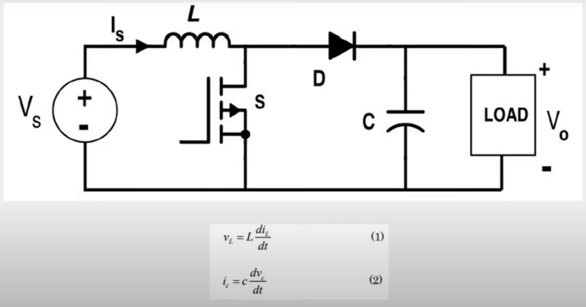
Mathematical Model of Boost Converter

Slide 18
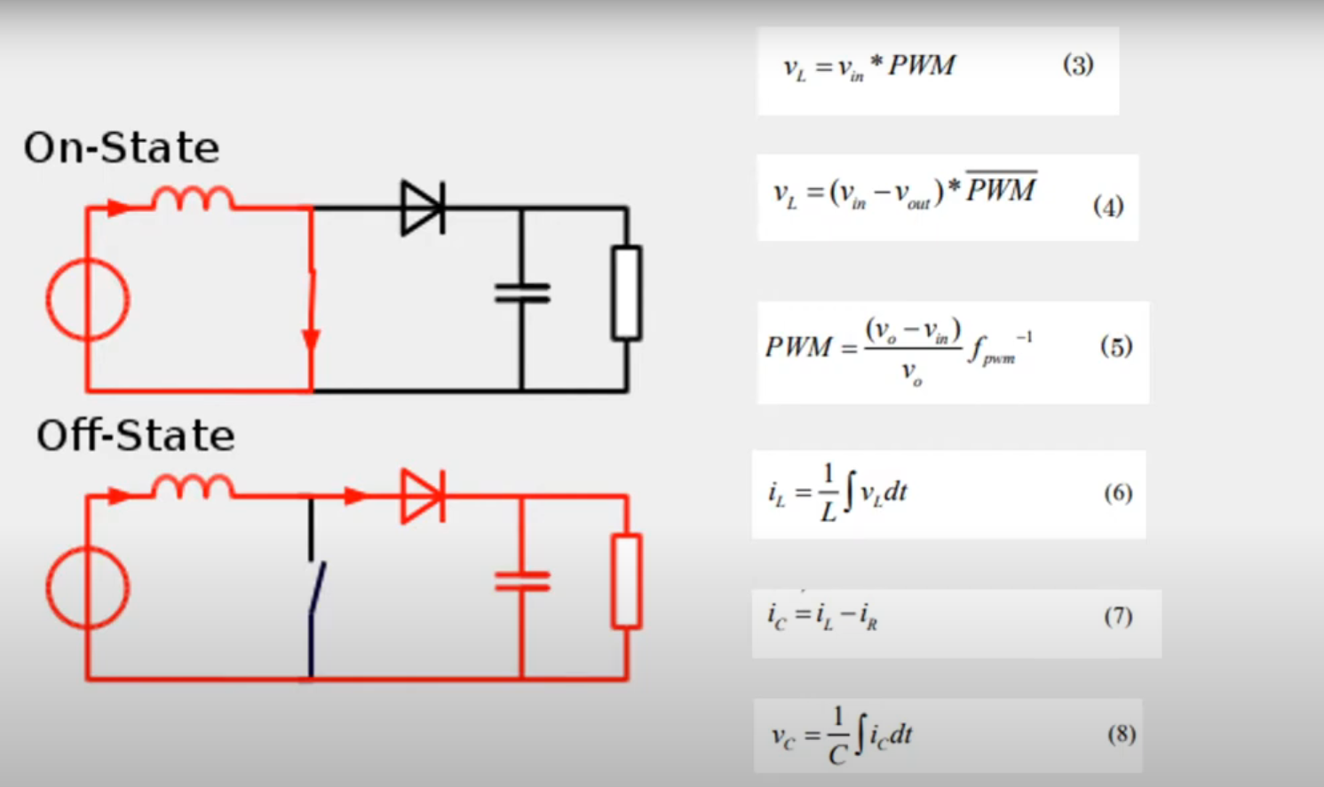

Slide 19
Voltage mode control of DC/DC converter
Advantages
Simple and industry wide used
Measured value compared to reference voltage to generate control voltage
Control voltage compared to fixed frequency waveform (sawtooth).
Disadvantages
Poor reliability of control
Slow response due to high order switching cycles
Poor reliability of switches

Slide 20
Current mode control
In this method, output voltage and input voltage is compared to generate reference current. This reference current Iref is then compared with the sensed sawtooth waveform of current in terms of voltage to generate the control switching duty ratio.
The control method's main drawback is subharmonic oscillations. These occur when the duty cycle goes beyond 50% in peak current mode control.
Advantages
i) improved transient response
ii) better line regulation
iii) self protection features
iv) suitable for DC\DC converters operating in parallel mode

Slide 21
THANK YOU😊

